Slide 1

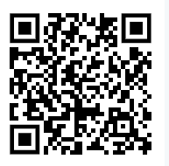
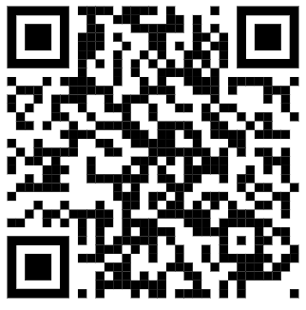


Getting ready …
We understand that children starting School can be an anxious and worrying time for both children and parents.
It is important that as a parent, you speak positively about the upcoming change and the exciting opportunities School will bring.
Take walks past school, watch the YouTube videos on our school website/channel and spend time talking about what exciting things they will be doing at School.
We looking forward to working with you.
am
ready
to
I
communicate
am
socially
ready
I
am
I
physically
am
ready
I
curious
Ready for School
Early
Learning
Our Website
Our YouTube
Our Instagram

Slide 2
Reception readiness isn’t about knowing numbers, letters
or shapes – it’s about being confident, curious and
independent enough to take part in Reception life.
We hope this leaflet helps you as parents/carers to celebrate
progress and explore areas where extra support may help
– from talking and playing, to toileting and independence.
Together, we’re getting every child ready to thrive in
Reception and beyond.
By building these everyday skills, we help children start
Reception at age 4 with feeling secure and ready to learn
– giving teachers time to teach, and children the best
possible start.
Remember, this is not about perfection or your
child mastering these skills... it’s about helping them
take part and start to learn helpful skills that will support
them. They do not have to be able to do everything,
but it is great to try!
Ready for School
Early
Learning
Early Learning
I turn the pages of a book one at a time
I can recognise and write my name
I can count to 10
I know and can join in with at least 5 nursery rhymes
I can listen attentively for at least 5 minutes
I can follow rules and routines (with some support)

Slide 3
am
socially
ready
I
am
I
physically
ready
Ready for School
Ready for School
I am socially ready. I can…
Leave my mummy/daddy/ carer happily with some reassurance
Play alongside or with other children (parallel play)
Shows awareness of other children (watches, copies)
Copy actions from adults around me
Share toys
Take turns
Express my feelings in simple ways
Calm myself with adult support
Accept comfort from a familiar adult (not just my parent/carer)
I am physically ready. I can…
Put on and take off my coat
Put on and take off my shoes
Feed myself using a spoon/fork
Drink from a cup
Use the toilet independently
Wash my hands with soap and dry them
Move safely around a room (walking, climbing, squatting)
Hold a pencil with a comfortable grip to make marks

Slide 4
am
ready
to
I
communicate
I
am
curious
Ready for School
Ready for School
I am curious. I can…
Try out new toys or activities
Explore toys in different ways (banging, posting, stacking)
Stay focused for at least 10 minutes on an activity I chose
Move between activities with support
Solve small problems (e.g. ‘piece doesn’t fit’)
Enjoy messy play, stories and creative play
Join in with Imaginary play (e.g., pretend to be a superhero saving the world
Cope with different sounds around me (e.g. singing, other children)
I am ready to communicate. I can…
Look at people’s faces and respond when spoken to
Follow two part instructions (e.g. Get your bag and put your books inside)
Use sentences to communicate
Join in with songs, stories and rhymes
Take turns in games and conversations
Listen to others and respond appropriately

